Slide 1



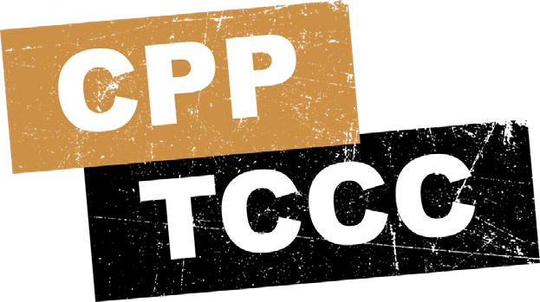

TACTICAL COMBAT CASUALTY CARE COURSE
MODULE 24: PREPARE FOR EVACUATION
Module 24: Prepare for Evacuation
#TCCC-CPP-PPT-24 16 FEB 22
COMBAT PARAMEDIC/ PROVIDER
TCCC TIER 1
All Service Members
TCCC TIER 2
Combat Lifesaver
TCCC TIER 3
Combat Medic/Corpsman
TCCC TIER 4
Combat Paramedic/Provider
Notes:
Presenter
2023-10-30 10:13:26
--------------------------------------------
This module discusses casualty preparation for evacuation during the Tactical Field Care (TFC) setting.

Slide 2




Module 24: Prepare for Evacuation
TACTICAL COMBAT CASUALTY CARE (TCCC) ROLE-BASED TRAINING SPECTRUM
ROLE 1 CARE
NONMEDICAL
MEDICAL PERSONNEL
PERSONNEL
YOU ARE HERE
STANDARDIZED JOINT CURRICULUM
#TCCC-CPP-PPT-24 08 AUG 23
2
Notes:
Presenter
2023-10-30 10:13:27
--------------------------------------------
All Service Members and Combat Lifesaver training educates non-medical personnel about supporting the casualty evacuation preparation process. Combat Medic/Corpsman training prepares medics to process casualties and be responsible for the transition of care from the Tactical Field Care setting to the Tactical Evacuation Care (TEC) phase. As Combat Paramedic/Provider (CPP) level medics, you will also often be involved in prolonged care during evacuation delays.

Slide 3
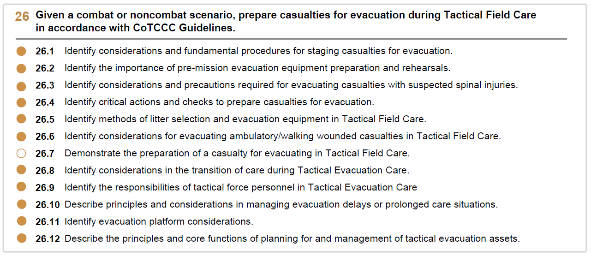







Module 24: Prepare for Evacuation
1 x TERMINAL LEARNING OBJECTIVES
Given a combat or noncombat scenario, prepare casualties for evacuation during Tactical Field Care in accordance with CoTCCC Guidelines.
  Identify considerations and fundamental procedures for staging casualties for evacuation.
  Identify the importance of pre-mission evacuation equipment preparation and rehearsals.
  Identify considerations and precautions required for evacuating casualties with suspected spinal injuries.
  Identify critical actions and checks to prepare casualties for evacuation.
  Identify methods of litter selection and evacuation equipment in Tactical Field Care.
  Identify considerations for evacuating ambulatory/walking wounded casualties in Tactical Field Care.
  Demonstrate the preparation of a casualty for evacuating in Tactical Field Care.
  Identify considerations in the transition of care during Tactical Evacuation Care.
  Identify the responsibilities of tactical force personnel in Tactical Evacuation Care
  Describe principles and considerations in managing evacuation delays or prolonged care situations.
  Identify evacuation platform considerations.
  Describe the principles and core functions of planning for and management of tactical evacuation assets.
12 x ENABLING LEARNING OBJECTIVES
= Terminal Learning Objectives = Cognitive ELOs = Performance ELOs
#
#TCCC-CPP-PPT-24 08 AUG 23
3
Notes:
Presenter
2023-10-30 10:13:27
--------------------------------------------
There are eleven cognitive and one performance enabling learning objectives in this module.
While focusing on identification of the important principles of preparing and staging casualties for evacuation you will also be learning about several related topics, to include the importance of pre-mission training, considerations for evacuation of a casualty with a suspected spinal injury, litter and evacuation equipment selection, and considerations for evacuation of ambulatory casualties. Additionally, the process of transitioning care to evacuation personnel and the responsibilities of tactical force personnel during the evacuation process will be discussed. The prolonged care during evacuation delays is also addressed, along with identifying, planning, and managing evacuation assets. Afterwards, you will demonstrate the preparation of a casualty for evacuation in the Tactical Field Care phase.

Slide 4

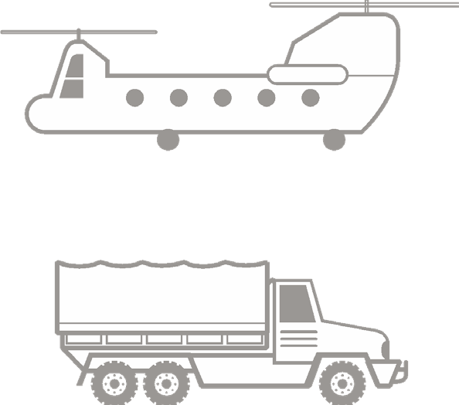
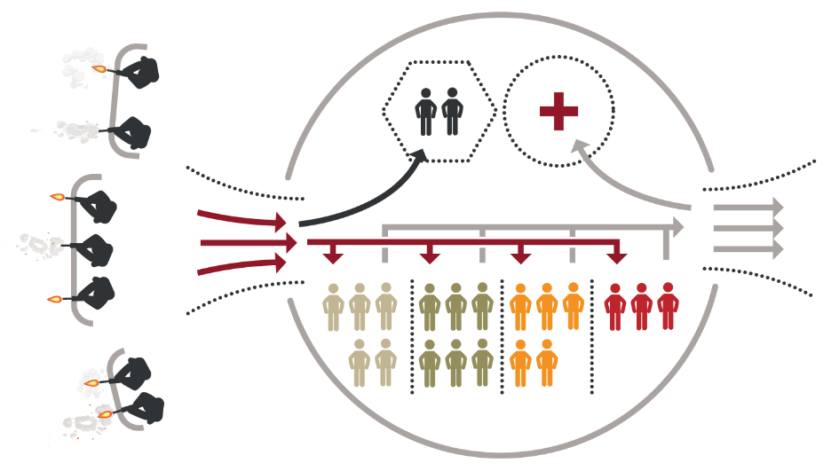

Module 24: Prepare for Evacuation
PREPARE FOR EVACUATION OVERVIEW
Package Casualties:
Secure loose bandages and wraps
Secure hypothermia prevention materials
Consider padding
Secure litter straps
Stage Casualties:
Follow unit SOPs
Move casualties to evacuation site
Provide instructions to ambulatory
Load casualties and transition care to receiving evacuation team
Complete DD Forms 1380
C&oamtptalecthe tDoD Fcoarsmua1lt3ie8s0s and secure to casualties
casualties, as needed
EVACUATION CHALLENGES
Insecure tactical environment Loud noise conditions
Physically difficult casualty transfers
ESTABLISH & MAINTAIN
security at evacuation point
4
Notes:
Presenter
2023-10-30 10:13:28
--------------------------------------------
Proper preparation for evacuation will help to ensure a smooth handover to evacuation personnel. Keep in mind that the transition is challenging for several reasons. The tactical environment may be somewhat insecure, the environment may involve loud noise conditions (like under spinning helicopter rotor blades or at the tail of a fixed-wing evacuation aircraft), and the receiving asset may be moving slightly (like on small boats rocking back and forth in rough seas).1 A smooth transfer of care in these hectic environments is facilitated by well-prepared casualties, preplanned procedures, rehearsals, and effective communication.2 Although each tactical situation and set of casualties will dictate the way you prepare casualties for evacuation, there are some basic principles common to all of them that can guide your actions and ensure the best possible outcome for the casualty.
In many situations, parts of casualty preparation for evacuation are integrated into the tactical trauma assessment and treatment steps, while other steps and individual tasks may be delayed until the staging phase. This is when many of the steps in the TCCC Guidelines are executed, to include completing and securing the DD Form 1380, as well as securing the loose ends of wraps, bandages, and hypothermia prevention materials, and tightening litter straps prior to movement.3
Once the casualties are prepared, the next step is to stage them for evacuation in accordance with unit standard operating procedures. This might be done twice, once near the treatment area and again at the evacuation location, if the evacuation pick-up site is located at a distance from the treatment site and there is a delay in evacuation. This is also when instructions will be provided to casualties, in particular the ambulatory casualties, to reduce the workload on the evacuation team during the casualty pick-up process. Also, it is vital to maintain security at the evacuation point in accordance with unit standard operating procedures, using the tactical forces personnel provided by the local unit leadership.
And lastly, when the assets arrive, the casualties must be properly loaded, following the guidance of the incoming evacuation personnel. As a Combat Paramedic/Provider, you will be responsible for the transition of care from your team in Tactical Field Care to the receiving evacuation team as the casualty enters the Tactical Evacuation Care phase. 1National Association of Emergency Medical Technicians. Prehospital Trauma Life Support, 9th Edition (2020). Chapter 12, 833-834.
2PHTLS reference 524
3Tactical Combat Casualty Care Guidelines, 15 December 2021, paragraph 19; available at https://deployedmedicine.com/market/31/content/40, accessed 23 Jan 22.

Slide 5
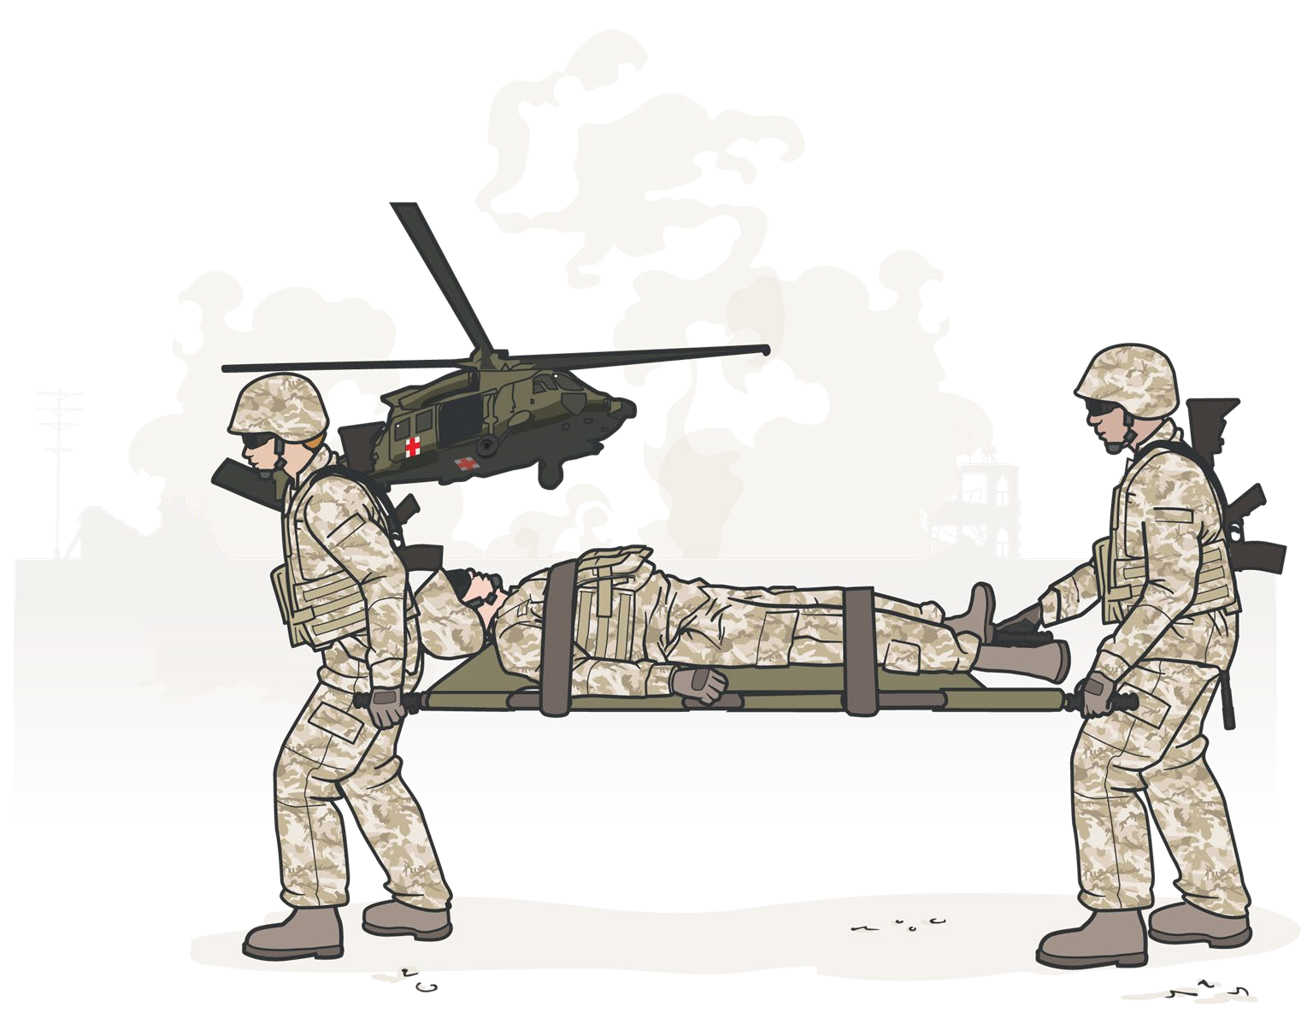
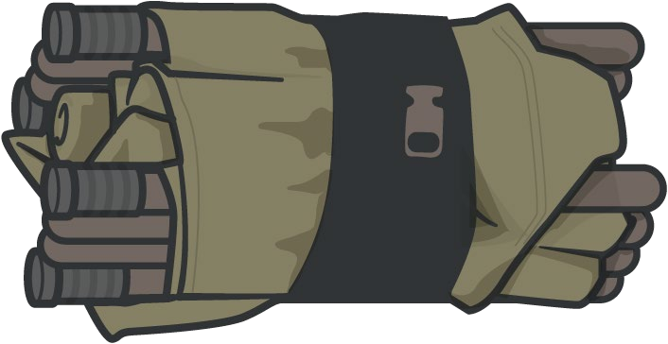
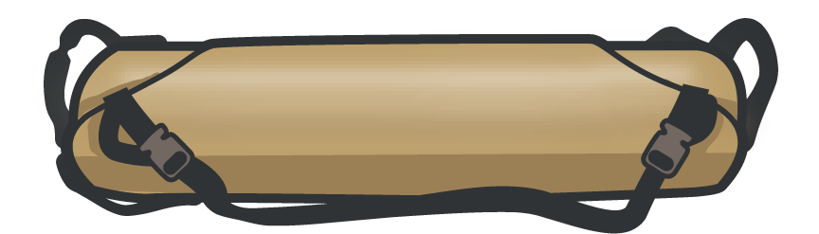
Module 24: Prepare for Evacuation
PRE-MISSION EQUIPMENT PREP AND REHEARSALS
PREPARE EVACUATION EQUIPMENT
Unit members should all know:
How to use evac equipment (set up and actual use)
Where to find equipment during a mission (storage location)
PRE-MISSION REHEARSALS
Primary roles for each member
Cross-training in other roles
Comprehensive dress rehearsals with simulated field conditions
Establish leadership Uncover weaknesses Build confidence
CPPs must inspect & inventory evacuation equipment prior to deployment and every mission
5
Notes:
Presenter
2023-10-30 10:13:28
--------------------------------------------
As you can imagine, several unit members are involved in choreographing a successful casualty evacuation. If the first time that unit members are involved in this process is during an actual evacuation, there is a significant risk that the team will not function well and the evacuation process will be delayed or the transition of care will be less than optimal, which could result in an adverse clinical outcome. So, it is important that pre-mission rehearsals be part of every unit’s training, both at home station and down-range.4
These rehearsals not only involve understanding the primary role each unit member will be expected to perform, but cross-training unit members so that they can assume the duties of other members, should another member become a casualty and need to be replaced. It is not enough to talk through the process, it is essential to run dress rehearsals where unit members perform their functions under your supervision. Carrying out the individual tasks uncovers problems that can be easily resolved and builds confidence in your unit personnel.
Another part of the pre-mission process is preparing evacuation equipment. At the onset of a deployment, most equipment is usually stocked and functional; but that should still be confirmed prior to departure from home station and after arrival. Once deployed, not only do you need to ensure equipment is in working order, you need to ensure all required equipment is present, as prior missions may have used assets that were not properly resupplied. This emphasizes why it is important to ask for equipment replacement during the evacuation request process. Also, key unit members need to know where the equipment will be located when out on a mission, and how to access it, as you will not have time to search for the equipment when you are providing or supervising casualty treatment. 4Headquarters of the Army. ATP 4-02.13. Casualty Evacuation, June 2021, Chapter 1, Section III (Casualty Training and Rehearsals). Available at https://armypubs.army.mil/ProductMaps/PubForm/Details.aspx?PUB_ID=1022529, accessed 23 Jan 22.

Slide 6
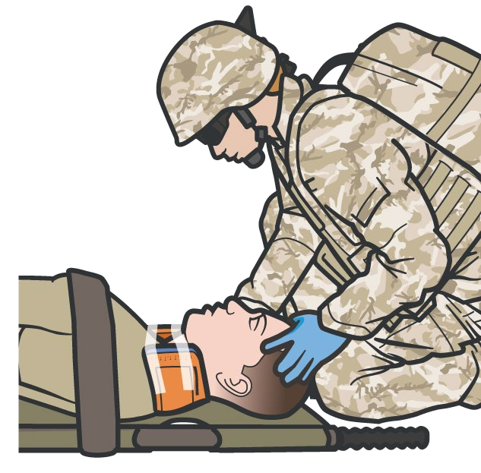
Module 24: Prepare for Evacuation
SUSPECTED SPINAL INJURY CONSIDERATIONS
C-spine stabilization is NOT necessary for casualties who have sustained only penetrating trauma
CONSIDER SPINAL INJURY in casualty with:
Blunt trauma with spinal pain
Visible hematoma/swelling along spine Radiating pain, unexplained sensory loss
Spinal immobilization is NOT a primary objective of Care Under Fire or Tactical Field Care
USE RIGID LITTER with adequate support to protect the spinal cord from sustaining secondary injury
CONSIDER USING MALLEABLE SPLINT
to form C-collar, if cervical injury is suspected and no commercial C-collar is available
If the tactical situation allows, consider addressing in preparation for Tactical Evacuation Care
Long spine boards and immobilization materials usually not available – consider requesting with MEDEVAC Request
6
Notes:
Presenter
2023-10-30 10:13:29
--------------------------------------------
The TCCC Guidelines highlight that cervical spine stabilization is not necessary for casualties who have sustained only penetrating trauma.5 Several studies and guideline papers from professional societies mirror that guidance.6 And because of the tactical considerations and treatment priorities in the battlefield environment, spinal immobilization, as a rule, is not a primary objective of Care Under Fire or Tactical Field Care phases. However, as the casualty transitions from TFC to TEC, there may be time and a permissive environment to address suspected spinal injuries. If the casualty is a victim of blunt trauma and experiencing spinal pain, has visible swelling or hematomas along the spine, or is experiencing radiating pain or unexplained loss of sensation in their extremities, spinal injury may be suspected.7
If suspected, a rigid litter that provides adequate support to help protect the spinal cord from sustaining secondary injury should be used, if possible. Long spinal boards and classic spinal immobilization materials are usually not available. If appropriate, they can be requested when calling in the MEDEVAC Request. If the injury involves the C-spine, a cervical collar can be improvised from a malleable splint or other material and applied to the casualty before moving. But if the suspected injury is at a lower level, the rigid litter with firmly applied straps to prevent undesirable moments during casualty transport should be adequate. During the transition of care to the receiving evacuation team, the suspicion of a spinal injury and any measures you have taken should be communicated.
5Tactical Combat Casualty Care Guidelines, 15 December 2021, paragraph 4.e.; available at https://deployedmedicine.com/market/31/content/40, accessed 30 Jan 22.
6Hawkins SC, Williams J, Bennett BL, Islas A, Kayser DW, Quinn R. Wilderness Medical Society Clinical Practice Guidelines for Spinal Cord Protection. Wilderness Environ Med. 2019 Dec;30(4S): S87-S99.
7Bennett J, M Das J, Emmady PD. Spinal Cord Injuries. [Updated 2021 Aug 26]. In: StatPearls [Internet]. Treasure Island (FL): StatPearls Publishing; 2022 Jan-. Available from: https://www.ncbi.nlm.nih.gov/books/NBK560721/, accessed 31 Jan 22.

Slide 7

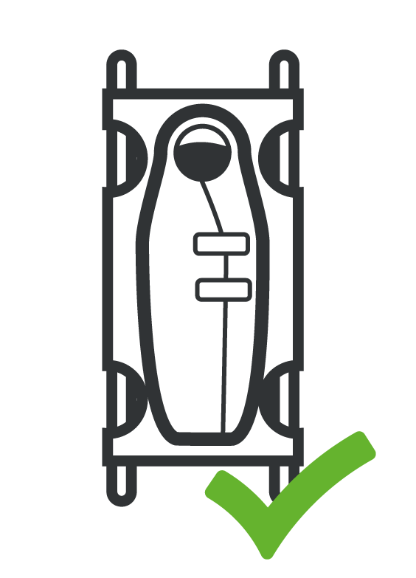
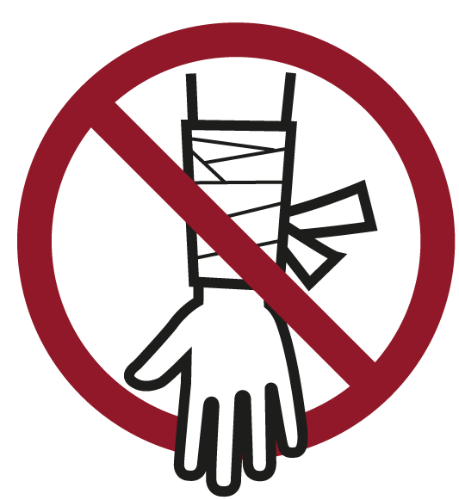

Module 24: Prepare for Evacuation
CRITICAL ACTIONS TO PREPARE CASUALTIES
Complete and secure
DD Form 1380 to the casualty
Attach complete DD Form 1380 to the casualty in a prominent location (wrist, belt loop of pants, etc.)
Secure all loose ends of bandages and wraps, and equipment
Secure hypothermia prevention wraps, blankets, & straps
Secure litter straps, consider additional padding
Ensure casualty’s weapons and equipment have been secured, as appropriate
7
Notes:
Presenter
2023-10-30 10:13:30
--------------------------------------------
Understanding that each situation is unique, there are some basic measures that should be followed for all evacuation preparation scenarios. The TCCC Guidelines outline the critical actions that should be followed. Although usually handled by unit leadership and fellow team members, ensure casualty’s weapons and equipment are secured, as appropriate.
Complete and secure the DD Form 1380 to the casualty. Some hypothermia shells or patient transport covers have a transparent pouch where you can put the DD Form 1380, but many do not. Options for securing it to the patient include attaching it to their wrist or other body parts if there is a band or taping it to them or their packing materials. Remember that the goal is to not have the casualty and their DD Form 1380 separated as they go through their continuum of care. So, however you secure it, make sure it will stay with the casualty.
Secure all loose ends of bandages and wraps. Loose treatment interventions pose risks for the casualty, the responders, and even the evacuation assets. For the casualty, a loose wrap or exposed tourniquet windlass can be caught on individuals working around the casualty or on the evacuation platform and be compromised, requiring that the intervention be reassessed and treated again, potentially worsening the clinical situation or delaying evacuation. Responders and personnel working around the casualty can get entangled in loose interventions and potentially hurt themselves. And anything that isn’t secure has the potential for breaking loose and can fly free, particularly in rotor wash or at the tail of an aircraft, both creating a projectile that can hurt personnel and debris that can damage the evacuation asset. Secure hypothermia prevention wraps, blankets, and straps. Similar to the prior discussion, the actual casualty wraps can be a problem for the very same reason. But even if they don’t break free and create those problems, the hypothermia prevention measures will not be effective if they are not properly secured. The wraps need to retain any heat being produced by the casualty or their heating device, which won’t happen if they are loose.
Secure litter straps as required. Consider additional padding for long evacuations. Litter straps are commonly loosened to allow access to the casualty for reassessment purposes, and occasionally they are not re-tightened afterwards, either for easy access or casualty comfort. However, when transporting the casualty and while in the evacuation asset, this can be a significant safety hazard. Be sure to check all straps and ensure each casualty has at least two straps. Litters are, by their very nature, uncomfortable. For short periods this is usually tolerated fairly well. But for prolonged waiting periods and long evacuation, this can add to casualty pain and stress and adversely affect their outcome. Whenever possible, add padding to provide casualty comfort, even if the casualty is not complaining of being uncomfortable.

Slide 8
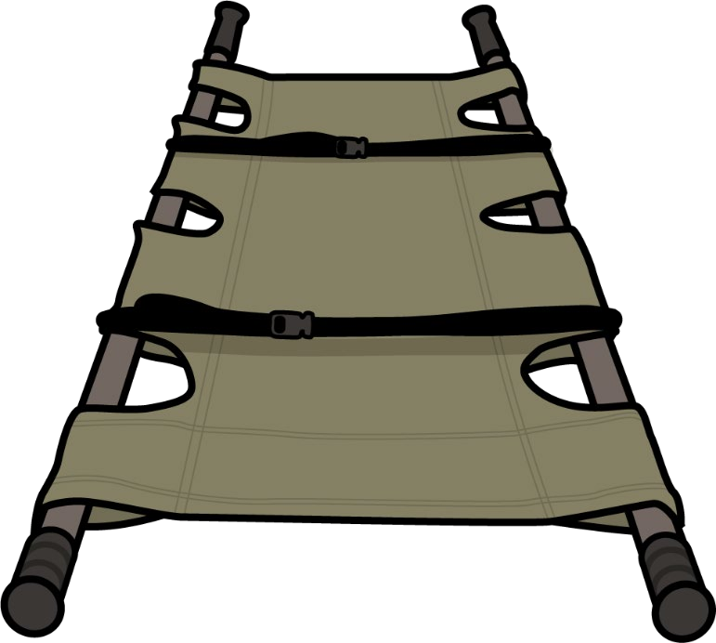
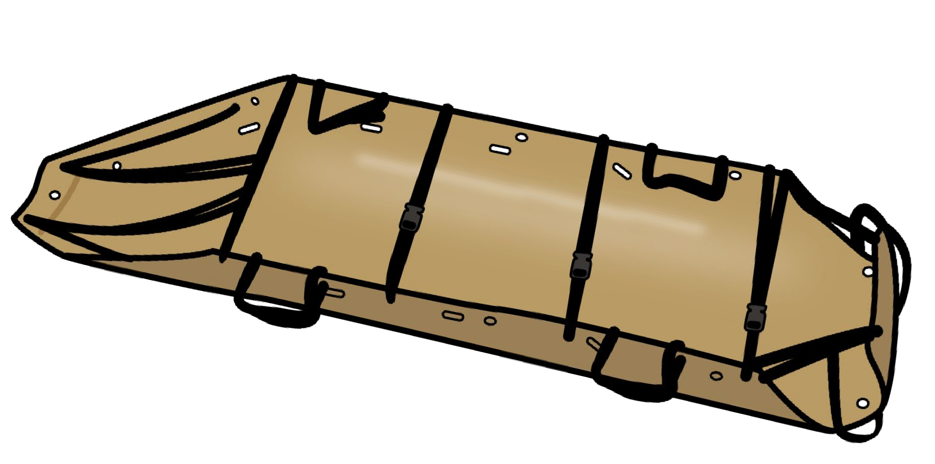
Module 24: Prepare for Evacuation
LITTER SELECTION
AND EVACUATION EQUIPMENT
Evacuation equipment determinants:
Unit standard operating procedures
Deployed mission environment (tactical situation, terrain, weather, and evacuation assets)
DO NOT DELAY getting casualties onto litters
Hypothermia is easier to prevent
off the ground
Easier to move casualty on litter
Collapsible litter pros/cons:
Sled type litters pros/cons:
Most common litters
Rigid poles/grips aid in transport/rough terrain
Integrated litter straps
Collapsible handles support H-60 MEDEVACs
No rigid poles – difficult grip over long distances
Integrated straps Some hoist-certified
Plastic – supports sliding on smooth surfaces
Needs good padding
Train on unit equipment, but familiarize yourself with as many different types as feasible
8
Notes:
Presenter
2023-10-30 10:13:31
--------------------------------------------
The types of litters and evacuation equipment you have access to will be determined by a combination of your unit standard operating procedures and the deployed mission environment. Ideally, you will have access to a few different assets, as each of them has advantages and disadvantages based on the tactical environment (terrain, weather, hostile threats) and the evacuation assets (air ambulance, air asset of opportunity, ground vehicles). Evacuation equipment (like litters & packaging materials) should be prepared by other unit personnel while treatment is rendered by medical personnel. Do not delay getting casualties onto litters as it is easier to prevent hypothermia when casualties are off the ground and casualty movement is facilitated litter transport.
Train on the equipment your unit supplies, but make every effort to expose yourself to, and even train on, other types of equipment; as you may very well encounter them when deployed. It is definitely an advantage to have equipment familiarity prior to using them in an operational setting.
The quad-fold Talon II® litter is perhaps the most common litter currently being used. Once set up properly, it has rigid poles, and the grips provide an advantage when transporting a casualty in rough terrain. It has integrated litter straps and the mesh material makes it easy to clean and useful in decontamination scenarios. Also, the Talon II litter has collapsible handles and will fit into standard H-60 MEDEVAC platforms, whereas some of the other litters like the Raven 90C® bi-fold litters do not fit properly.
Skedco™ litters are commonly used tactical litters in light infantry and airborne units. They do not have rigid poles, so carrying them by their handles is not easy and can be tiresome over distances. However, they do function well as drag or slide devices, and if the terrain is smooth, they can be easily pulled by one or two responders, being cautious not to let them slide out of control when going downhill. They are often used to carry gear and ammunition into the mission and carry casualties out. And properly rigged, they can be hoisted into a helicopter or Osprey, although not all versions are hoist-certified.

Slide 9
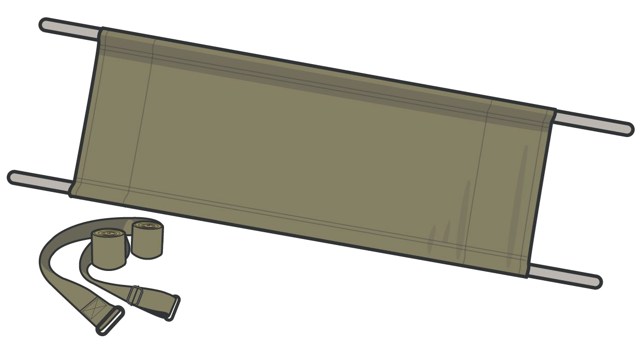
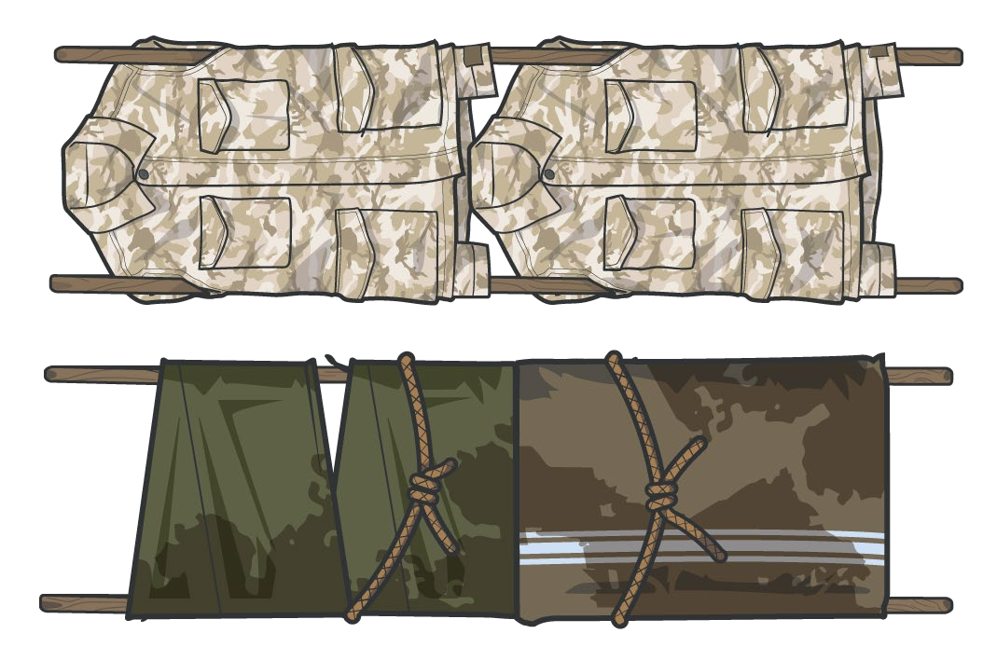
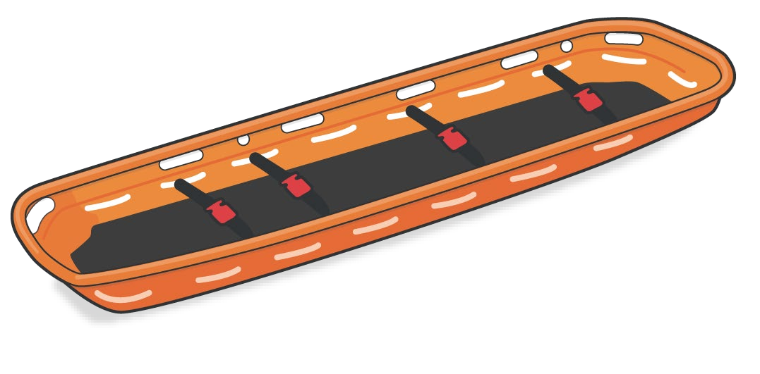
Module 24: Prepare for Evacuation
LITTER SELECTION
AND EVACUATION EQUIPMENT (cont.)
“Army standard litter” pros/cons:
Basket type litter pros/cons:
Improvised litter pros/cons:
Poles don’t collapse Requires external litter straps
Commonly seen in multinational operations
Usually found in rescue units
Some (not all) litters fit inside basket
Can be dragged
Generally, preferred litter for hoisting
Rigid pole materials often difficult to locate
Can be made with rope, blankets or jackets
Potential to harm casualty, if not properly constructed
Significant variation exists within NATO litter standards
Notes:
Presenter
2023-10-30 10:13:32
--------------------------------------------
The “Army standard litter” is another option for a tactical litter. It does not have preinstalled litter straps, so these will need to be carried on the mission as well. Many countries have variations of this litter, with rigid poles and canvas material liners, so it is common to see these in multinational operations. There is wide variability in what is considered NATO-standard, and not all NATO-standard litters will fit into US evacuation assets.
The Stokes litter may be used by rescue units but is not typically carried by ground combat units. It is a basket litter, sometimes made of wire mesh, metal materials, and sometimes plastic. The casualty can usually be placed inside the basket in a Skedco litter, but it will not accommodate a rigid pole litter and might require casualties be transferred if the evacuation platform requires the use of this litter. Stokes litters can be dragged by two rescuers, if necessary, but four rescuer carry configuration, is not uncommon.
In the absence of a dedicated litter, it is possible to fashion improvised litters. There are several techniques, but most involve selecting rigid pole-like materials, and then using ponchos, poncho liners, blankets, field jackets, or other field-expedient materials to form the bed of the litter. A rigid transport platform, like a door, is also an option if properly padded. Casualty safety is important, so care must be used to ensure any improvised litter will be able to support the casualty’s weight, be relatively easily carried by a litter team, and not risk significant casualty movement during transport. Choosing a litter may be based solely on equipment availability; but if multiple options are available, then base your decision on a combination of the terrain and tactical considerations, the unit personnel you have to support casualty movement, and the evacuation asset you anticipate using.

Slide 10

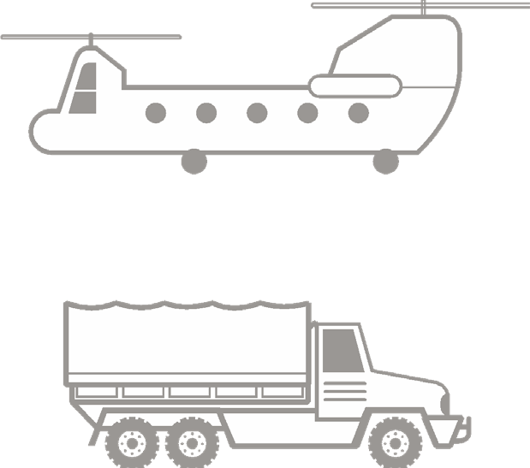


Module 24: Prepare for Evacuation
CASUALTY EVACUATION STAGING
STAGE in close proximity to the evacuation site
If not at treatment site, MOVE TO STAGING AREA when evac assets are en route
PROTECT CASUALTIES from
environmental elements
MONITOR for hypothermia and dehydration
ARRANGE CASUALTIES IN ORDER
of loading precedence (usually routine first and urgent last)
Ambulatory
1 and routine casualties
ROUTINE
2
Priority casualties
PRIORITY
Urgent casualties
Evacuation personnel dictate the exact order of casualty movement
3
Periodically reassess tourniquets, dressings, IV lines or other interventions
URGENT
Notes:
Presenter
2023-10-30 10:13:33
--------------------------------------------
Staging typically occurs in close proximity to the evacuation site, and if not co-located with the treatment site, the casualties are moved there in advance of the evacuation asset arrival. Although you do not want to have the asset waiting for the arrival of the casualties, you also do not want to have the casualties arrive too soon if the environment is not ideal for waiting long periods of time. Remember, when moving casualties over long distances, tourniquets, dressings, IV lines, or other interventions should be checked periodically to ensure they are intact and functioning. You should definitely do this upon arrival at the staging site, if not along the way.
In transit and once at the staging area, casualties should be protected as much as possible from environmental elements (like the sun, rain, wind, or cold) and observed for signs of hypothermia or dehydration.
At the site, the casualties should be arranged so that they can be loaded in sequence, according to their movement priority and clinical status. This may be dictated by unit procedures, or it may be provided by the evacuation platform personnel. In general, when feasible, ambulatory and routine casualties are loaded first, followed by priority casualties, and urgent casualties are loaded last. This allows for urgent casualties to have the least amount of time on the evacuation platform, and more importantly, to be the first off of the asset once it arrives at its destination. Once the evacuation asset arrives, the personnel responsible for loading casualties will dictate the order of casualty movement, regardless of the way the casualties were arranged by the ground medical team.

Slide 11
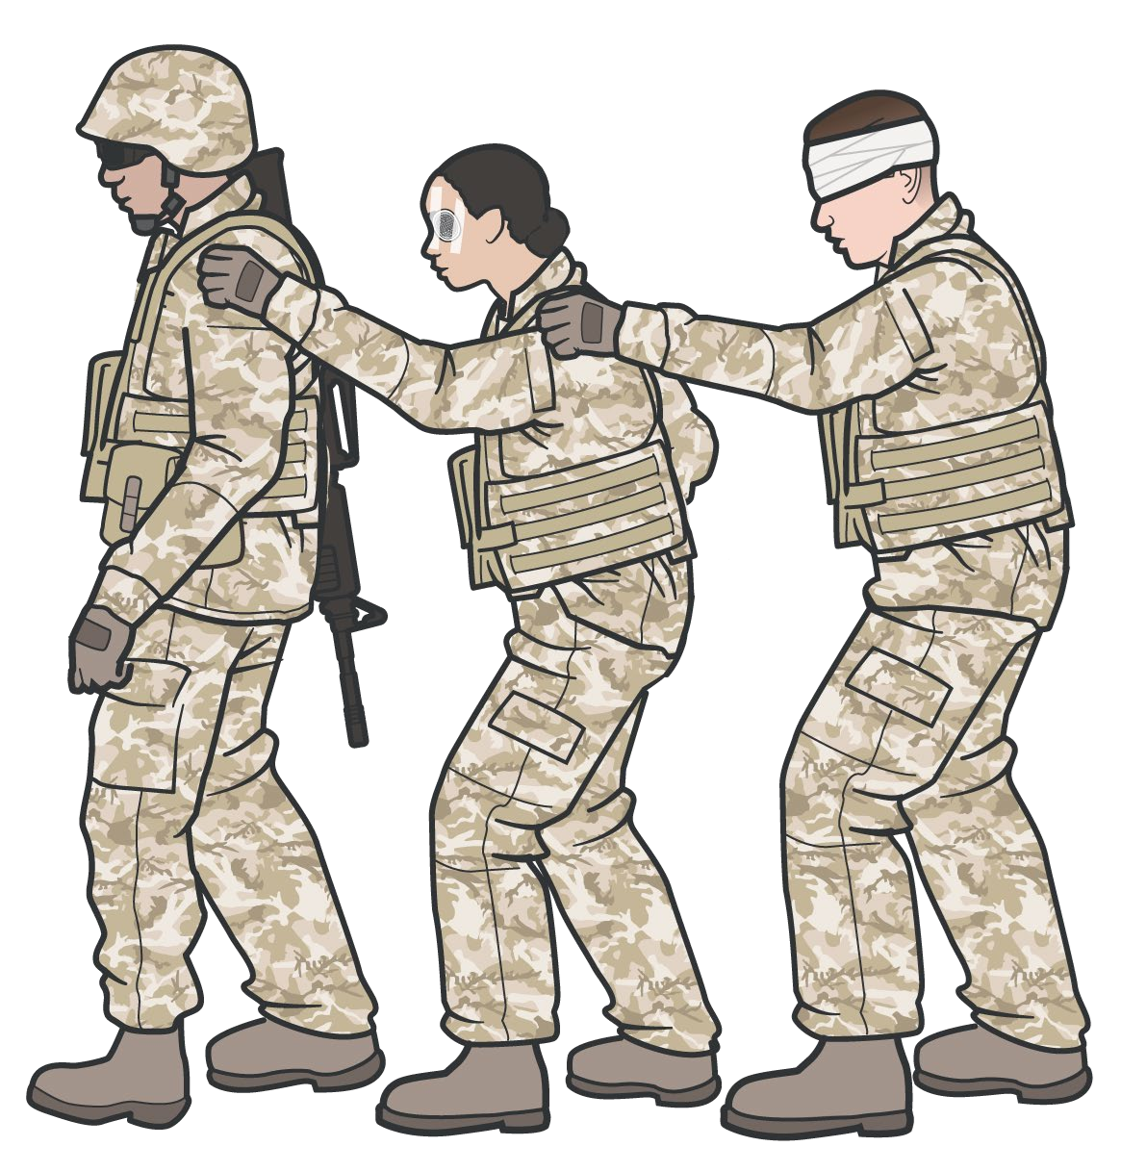
Module 24: Prepare for Evacuation
AMBULATORY CASUALTY CONSIDERATIONS
Can the ambulatory casualty help?
Are they capable of providing security?
Could they help lift a littered casualty?
Can they help other ambulatory casualties?
Disoriented or visually impaired casualties require supervision during evacuation
Assign uninjured unit member as POC: Answer questions for ambulatory casualties Periodically reassess ambulatory casualties
Instruct casualties to repeatedly check their wounds and dressings & ensure that bleeding remains controlled
When moving, line up casualties and have each place their hand on the shoulder of the casualty in front of them
Notes:
Presenter
2023-10-30 10:13:33
--------------------------------------------
The TCCC Guidelines highlight the requirement to provide instructions to ambulatory patients as needed. As part of the casualty preparation phase or the evacuation staging phase, depending on the situation, time should be taken to address ambulatory casualties and how they will be handled during the evacuation process.
Once you have determined that a patient is able to ambulate, it is important to assess their capabilities to assist in the evacuation process, either through being self-sufficient or perhaps even supporting others. For example, are they capable of providing security? Could they help lift a littered patient? Or can they help watch out for and/or care for other ambulatory casualties?
If they are able to help with the evacuation process, provide them clear guidance on the role you want them to perform and assign an uninjured unit member to be their point-of-contact (POC) if the casualty feels their situation is changing and they can no longer help out. Have that POC keep an eye on them, too, as they should be reassessed for potential changes in mental status or capabilities from time to time.
Disoriented or visually impaired casualties require supervision to be evacuated, even if they are ambulatory. This can be done by a non-medic and done in groups if there are several. When they need to move as a group, like when approaching the evacuation platform, they should line up and each place their hand on the shoulder of the casualty in front of them and follow their lead, with the lead casualty being someone without visual impairment or disorientation (another casualty, a Combat Lifesaver or other uninjured non-medic). To reduce the workload on the supporting medical personnel, instruct ambulatory casualties on repeatedly checking their own wounds and dressings to ensure that bleeding remains controlled and there isn’t a change in their status, advising them about who to notify if there is a change.

Slide 12
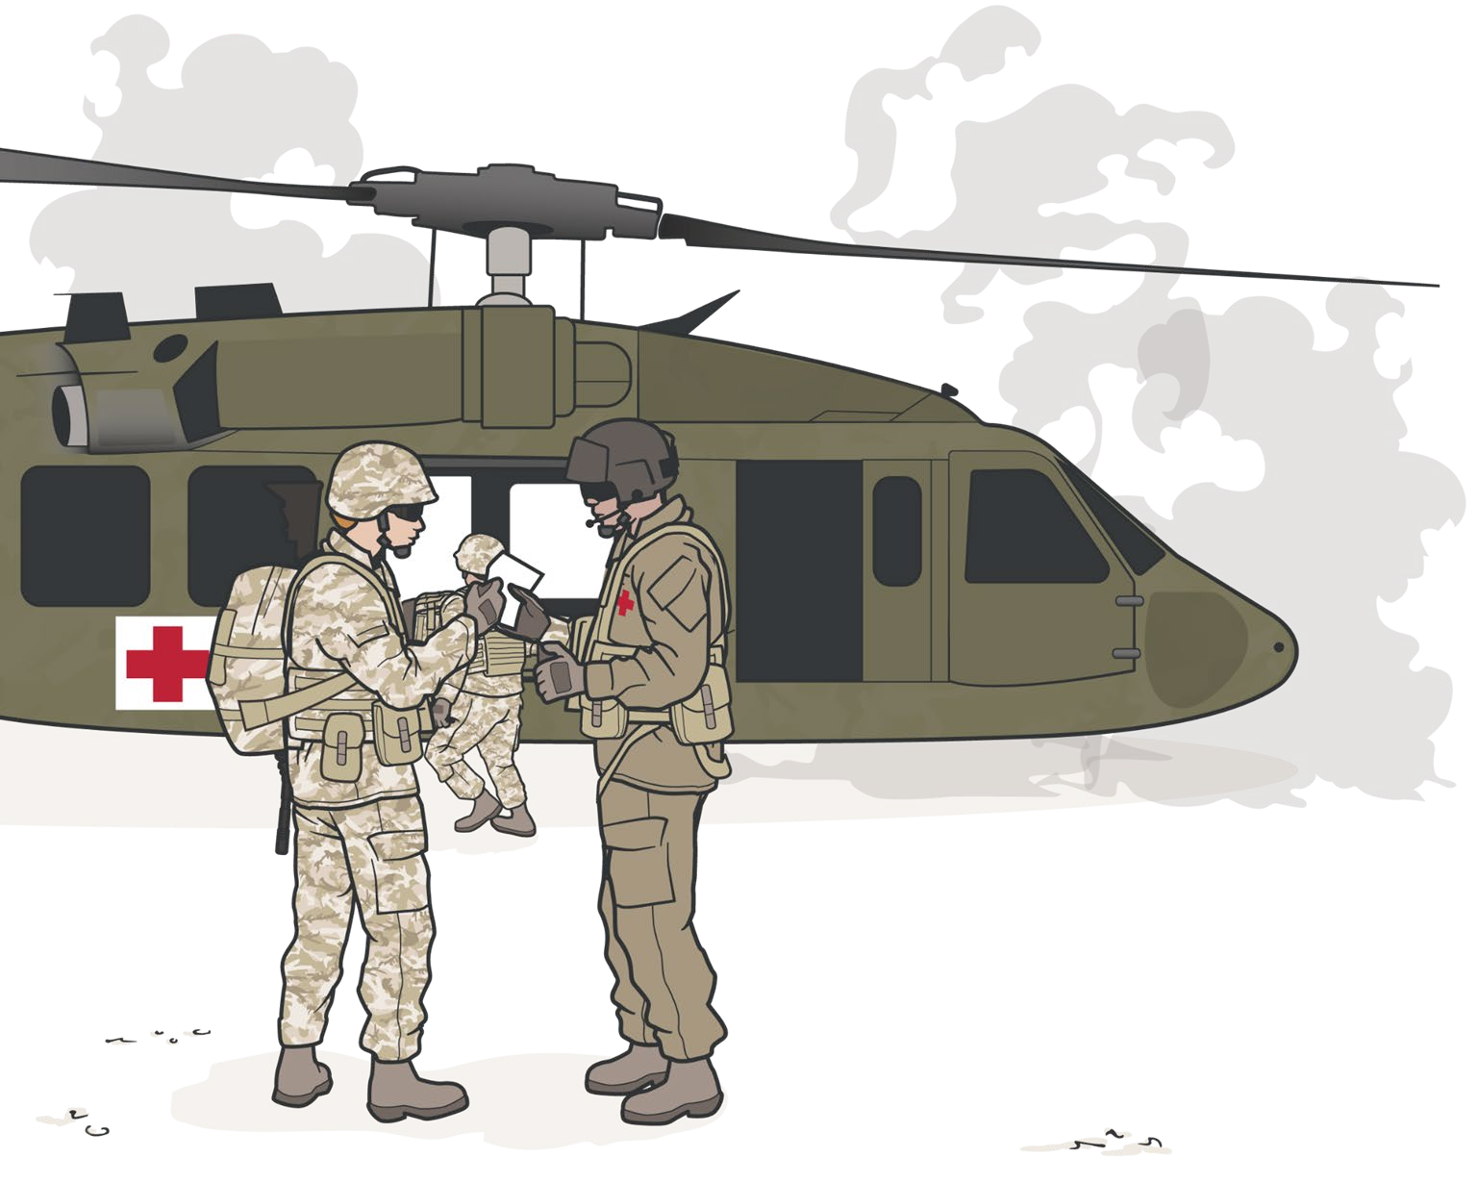
TRANSITIONING CARE
TO EVACUATION PERSONNEL
Module 24: Prepare for Evacuation
Have accurate, completed DD Form 1380s Have MIST report prepared for each casualty Identify the receiving care provider
Make direct contact (visual, verbal, etc.)
Establish method of communication (radio, verbal, written)
Relay MIST report(s) Answer any questions
NEGATIVE IMPACTS on transition of care:
Hostility threats in exposed environments Reduced ground time (fuel limits, etc.) Engine noise and rotor wash
GOOD casualty care management transfers improve outcomes
Notes:
Presenter
2023-10-30 10:13:34
--------------------------------------------
A critical step in casualty management is successfully transitioning care from one provider to another. In the civilian setting, there is overwhelming evidence that less-than-ideal hand-offs and inadequate communication of patient information lead to poor clinical outcomes.8 Despite the fact that there are fewer military-based studies, anecdotal evidence from battlefield casualty care management transfers indicates that this is true in the tactical environment, as well.9
There are several environmental factors that can negatively impact the transition of care and sharing of information in the tactical environment. The threat of hostilities in an exposed location leads to a requirement to minimize the time on ground during an evacuation by air assets, as does the fact that fuel levels may be limited. The noise and rotor or engine wash can reduce eye contact and hearing thresholds, leading both parties to look for abbreviated means of communication. The casualty evacuation process is not part of the unit’s mission objectives and there is pressure to transition back to normal operations as soon as possible. All of these things, and more, can have a negative impact on the transition of care if not mitigated properly. One very important tool to help provide adequate casualty information is the make sure that the DD Form 1380 is fully completed, up-to-the-minute, and accompanies the casualty throughout their journey.
That said, there are subtle findings and experiences from assessing and treating the casualty that are more appropriately passed along in a verbal transition of care. So, you should be prepared to provide a MIST (Mechanism, Injuries, Signs, Treatment) report, focusing on those aspects that might not be self-evident from the DD Form 1380, including your sense of the casualty’s stability for evacuation. As mentioned, there are several factors that might be obstacles to this in the tactical situation, and you should be prepared to address those as they arise. Some potential ways to do that include:
Identifying the receiving care provider on the evacuation.
Establishing direct contact with that provider – through eye, verbal or hand contact, let them know that you will be providing them information on the casualties.
Establishing a means of communication – this might be through direct verbal exchanges, radio communications if they have a spare headset available, or in worst-case scenarios through hand motions and pointing at written documentation. Providing the MIST report, to include treatments that should be continued during the evacuation phase.
Answering any questions that they have prior to departure.
8Mansukhani RP, Bridgeman MB, Candelario D, Eckert LJ. Exploring Transitional Care: Evidence-Based Strategies for Improving Provider Communication and Reducing Readmissions. P T. 2015;40(10): 690-694. 9Hatzfeld JJ, et al. Top 10 Research Priorities for U.S. Military En Route Combat Casualty Care, Military Medicine, Volume 186, Issue 3-4, March-April 2021, e359–e365.

Slide 13
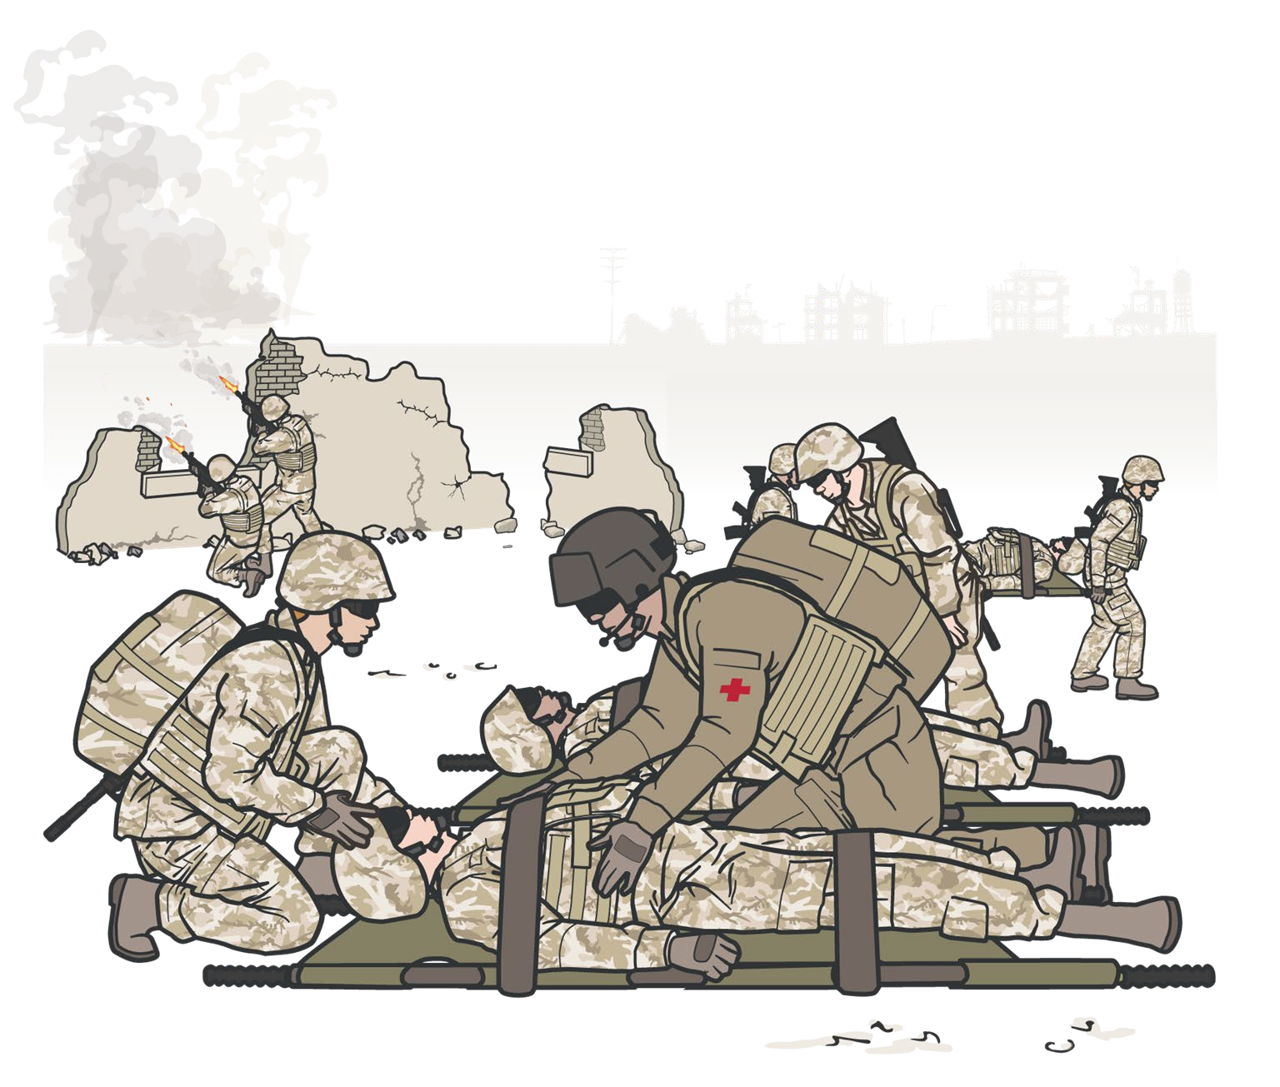
Module 24: Prepare for Evacuation
TACTICAL FORCE PERSONNEL RESPONSIBILITIES
Tactical force personnel are responsible for:
Identifying an evacuation site
Marking and preparing the evacuation site Securing the evacuation site
Leadership is tasked with:
Ensuring the safety of casualties Ensuring the safety of tactical personnel Maintaining awareness of potential hostile
threats that could impact the success of the evacuation
The entire unit, including medical personnel, should be prepared to support security requirements
Notes:
Presenter
2023-10-30 10:13:34
--------------------------------------------
Tactical force personnel are responsible for identifying, securing, marking, and preparing the evacuation site (helicopter landing zone, ambulance loading point, etc.) in advance of the arrival of evacuation assets.
Unit standard operating procedures will likely govern security at the evacuation point, and the entire unit, including medical personnel, should be prepared to support unit leadership in that process. The potential for exposing the unit and the evacuation team to hostile forces is significant and maintaining security is vital to the success of the evacuation process.
Tactical leadership will define the security measures and inform medical personnel of the parameters that will guide their casualty staging plan. Throughout the process, leadership is multi-tasked with ensuring the safety of both casualties and the tactical personnel who are moving the casualties and maintaining awareness of potential hostile threats that could impact the success of the evacuation.

Slide 14
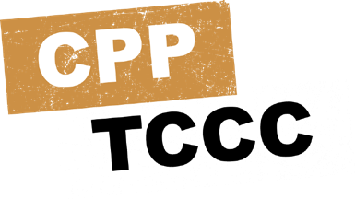

Module 24: Prepare for Evacuation
PREPARE FOR EVACUATION
Video can be found on deployedmedicine.com
Notes:
Presenter
2023-10-30 10:13:35
--------------------------------------------
This video will review the basic steps you should follow when preparing a casualty for evacuation. Play video.

Slide 15

PREPARE FOR EVACUATION SKILL STATION
Module 24: Prepare for Evacuation
Litter Selection
Casualty Preparation Casualty Staging Transition of Care
Notes:
Presenter
2023-10-30 10:13:35
--------------------------------------------
During this skill station, you will demonstrate the process of preparing casualties for evacuation, including documenting care, choosing the right litters, preparing the casualties, staging the casualties, securing the evacuation site, and transitioning care to a receiving provider.

Slide 16

MANAGING EVACUATION DELAYS AND PROLONGED CASUALTY CARE SITUATIONS
Module 24: Prepare for Evacuation
Steps of PCC
Principles
Perform initial care using TCCC Guidelines
Delineate roles and responsibilities
Perform comprehensive history and exam; develop problem list and care plan
Record and trend vital signs
Perform a teleconsultation
Create a nursing care plan
Implement team wake, rest, chow plan
Anticipate resupply and electrical issues
Perform periodic mini rounds assessments
Complete all TCCC Guideline- recommended assessments and treatments
Refer back to the assessment and treatment recommendations
in the TCCC Guidelines
Continuously re-triage as if you are taking care of multiple casualties
Confirm evac requests have been sent and received
Obtain and interpret lab studies
Perform necessary surgical procedures
Prepare for transportation or evacuation
Prepare documentation for handover
Notes:
Presenter
2023-10-30 10:13:35
--------------------------------------------
With the ever-changing nature of military operations, the likelihood of experiencing significant delays in casualty evacuations is increasing, leading to requirements for prolonged casualty management.10 For several years, increasing research and guidance into prolonged casualty care, or prolonged field care, has been advancing the body of knowledge for this topic and leading to recommendations or guidelines based on best practices and what evidence-based results are available. One of the key documents summarizing much of that guidance is the Joint Trauma System’s Prolonged Casualty Care (PCC) Guidelines.11 The details of prolonged casualty care management are complex and warrant additional training and exercise, but it is worth highlighting a handful of the basic principles during this TCCC training module. The basic principles of PCC are defined as completing all TCCC Guideline-recommended assessments and treatments, continuously re-triaging as if you are taking care of multiple casualties, confirming evacuation requests have been sent and received, and when in doubt, referring back to the assessment and treatment recommendations in the TCCC Guidelines.
More specifically, the PCC Clinical Practice Guideline-recommended steps are:
Perform initial lifesaving care using TCCC Guidelines and continue resuscitation. Delineate roles and responsibilities, including naming a team leader.
Perform comprehensive physical exam and detailed history with problem list and care plan. Record and trend vital signs.
Perform a teleconsultation. Create a nursing care plan.
Implement team wake, rest, chow plan. Anticipate resupply and electrical issues. Perform periodic mini rounds assessments. Obtain and interpret lab studies.
Perform necessary surgical procedures. Prepare for transportation or evacuation care. Prepare documentation for patient handover.
It is important to dedicate time to learning more about PCC and incorporate PCC scenarios in your pre-deployment training plans.
10Keenan S, Riesberg JC. Prolonged Field Care: Beyond the “Golden Hour”. Wilderness & Environmental Medicine. Volume 28, Issue 2, Supplement, 2017, S135-S139.
11Remley M, et al. Prolonged Casualty Care Guidelines (CPG ID:91). Joint Trauma System. Available at: https://jts.amedd.army.mil/assets/docs/cpgs/Prolonged_Casualty_Care_Guidelines_21_Dec_2021_ID91.pdf, accessed 5 Feb 22.

Slide 17

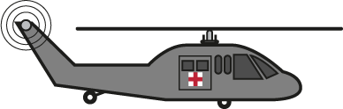
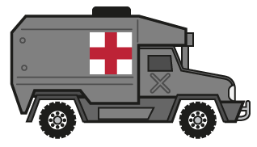
Module 24: Prepare for Evacuation
EVACUATION PLATFORM CAPABILITIES AND CONSIDERATIONS
Evacuation Mode | Dedicated Evac Assets | Evac Assets of Opportunity
Ground | M997 Ambulance M1035 Ambulance M113 Ambulance Others | Carries, drags, and litters Non-med wheeled vehicles Non-med tracked vehicles Local civilian ground assets
Rotary-Wing | UH-60Q Black Hawk | CH-46 Sea Knight CH-47 Chinook CH-53 Super Sea Stallion MV-22 Osprey Others
Fixed-Wing | None | C-130 C-17 KC-135 Others
Sea | Naval Hospital Ships | LHDs Others
Training and exercising on the platforms your unit will most likely encounter is essential
Notes:
Presenter
2023-10-30 10:13:36
--------------------------------------------
The evacuation platforms that you might encounter vary from mission to mission and unit to unit. So, it is extremely important that you help develop and follow your unit SOPs and train on those assets that you are most likely to encounter when deployed. If you deploy to an area where other types of assets are common, for example, in multinational operations, it is also very important to dedicate time to learning about those platforms and exercise casualty movement scenarios in advance of operations whenever possible. There are some reference materials to help describe evacuation platform capabilities, like Army Techniques Publication (ATP) No. 4-02.13 (Casualty Evacuation),12 ATP No. 4-02.2 (Medical Evacuation,13 or the United States Marine Corps Field Medical Training Battalion Publication Coordinate Casualty/Tactical Evacuation (TACEVAC).14 But each asset will also have additional training manuals and specific guidance that will need to be reviewed and used during pre-deployment training and exercises.
In general, evacuation platforms exist for ground, rotary-wing air, fixed-wing air, and sea. Although there are dedicated evacuation platforms for ground, rotary, and sea, there are no dedicated fixed-wing evacuation assets. And all four modes of transportation can also use vehicles of opportunity, increasing the number and types of evacuation platforms you might encounter. If fixed-wing or sea assets are likely to be used by your unit or at your deployed location, additional asset familiarization should be sought.
Ground assets you should be familiar with include the M997 Ambulance (capable of transporting up to 4 litter or 8 ambulatory patients), and the M1035 Ambulance (capable of transporting 2 litter and 3 ambulatory patients), the M113 (track) armored personnel carrier, ambulance buses and a handful of others. But there are several non-dedicated transportation assets of various sizes that can be configured to serve as ground evacuation assets, to include the M998 HMMWV in either the 2-person or 4-person configuration, the M1081 light medium tactical vehicle 2 1/2-ton truck, the M1093 medium tactical vehicle 5-ton truck, the MK 23 7-ton truck, the M977 heavy expanded mobility tactical truck, the M1075A1 Palletized Load System, and the M1120A4 Load Handling System, just to mention a few. You should also be familiar with the only dedicated rotary-wing evacuation asset, the HH-60 Black Hawk, a UH-60A modified for medical evacuation. It can carry up to 6 litter patients if a litter modification kit is installed, or up to 7 ambulatory patients if the litter modification kit is not installed, and patients can be loaded from either side. Other non-dedication rotary assets include the CH-46 Sea Knight, the CH-47 Chinook, the UH-1 Huey, the CH-53 Super Sea Stallion, other UH-60 Black Hawks, or the MV-22 Osprey, in addition to others.
12Available at https://armypubs.army.mil/epubs/DR_pubs/DR_a/ARN32888-ATP_4-02.13-000-WEB-1.pdf, accessed 5 Feb 22.
13Available at https://armypubs.army.mil/epubs/DR_pubs/DR_a/pdf/web/ARN17834_ATP%204-02x2%20FINAL%20WEB.pdf, accessed 5 Feb 22. 14Available at https://www.trngcmd.marines.mil/Portals/207/Docs/FMTBE/Student%20Materials/FMSO%20Manual/109.pdf, accessed 5 Feb 22.

Slide 18

PLANNING FOR AND MANAGING TACTICAL EVACUATION ASSETS
Module 24: Prepare for Evacuation
Be Part of Tactical Evacuation Management
Large-scale operation with dedicated assets
Actively Participate in Evacuation Planning
Integrate into the planning team
OR
Seek out and work with medical planners
Variable supporting roles
Possibly involved in decision-making process
Evacuation Plan | Evacuation Asset
Primary | Military ground ambulance
Alternate | Military wheeled vehicle
Contingency | Civilian ground ambulance
Emergency | Civilian wheeled vehicle
Smaller operations with assets of opportunity
Initiate the evacuation process
Provide ops personnel necessary information on destination and transport considerations
Coordinate with receiving medical facility Coordinate med or non-medical attendants
Work with operations personnel prior to and during deployment to be a known part of their process
Develop a PACE plan for each phase of the evacuation process
Notes:
Presenter
2023-10-30 10:13:36
--------------------------------------------
Although planning for evacuations and determining the assets that will be needed for a given operation is principally done by the medical planning community, you have a very important role in that process as a CPP. Not all planners have had the clinical experience, and sometimes the operational experience, to properly predict the types of casualties that might be generated and understand the impact of resource limitations on clinical outcomes. Your role, if you are not integrated directly into the planning team, is to seek out the medical planners and work with them to develop evacuation requirements and prepare for contingencies that might arise if evacuations are delayed.
The evacuation plan, like all emergency action plans, should include primary, alternate, contingency and emergency (PACE) considerations, and account for the most likely injuries or illnesses that could require evacuation. Each of those components may define a different potential asset to be used for evacuation purposes, and those assets could be dedicated (for example, a ground ambulance), shared assets being used primarily by other members of your unit (like a heavy expanded mobility tactical truck), assets you might have access to in the local area (civilian ground ambulances, as an example), or likely assets of opportunity (local cars or trucks that could be used in an emergency). The PACE planning approach should be used for each phase of a potential casualty evacuation. The role you play in tactical evacuation asset management will vary from unit to unit, and operation to operation. But like so many other things, if you do not actively seek to play a role in the process, you will have less control over your casualty evacuations when they occur.
In the case of a large-scale operation, there may be dedicated evacuation assets with their own command and control network, as we saw in some of the OIF and OEF operations. In those situations, you may have a supportive role that ranges from coordinating the evacuation requests and relaying casualty information that supports decision-makers at the operations center, to being part of the decision-making process on the best mode of evacuation and ideal destination based on the casualty’s condition. However, in smaller operations, particularly when the assets are not dedicated evacuation platforms, but assets that are set aside as primary evacuation platforms during periods of increased threat of casualties, one of your primary roles may be to authorize activation of that asset and provide input on the receiving medical facility. This may be true whether it is a ground asset or an air asset.
It will be your decision on whether an evacuation should be initiated and conveying necessary information to the appropriate command and operations centers. The transportation and or flight operations personnel will take primary responsibility for activating the crews to man the asset, and for the actual movement, but the responsibility for coordinating with the appropriate accepting medical facility and providing the operations personnel the key information about the destination and any enroute concerns falls on you. Additionally, if you feel a medical or non-medical attendant is necessary for the evacuation, this will need to be coordinated with leadership and the operations personnel. The asset may need to remain a while longer at the destination to allow the attendant to perform the casualty hand-off and return to the evacuation asset if they need to return right away. Managing tactical evacuation requires you to be familiar with the people and processes used in casualty movement, which cannot be accomplished at the time of the evacuation – it needs to be part of your pre-deployment training and your down-range dress rehearsals.

Slide 19
SUMMARY
Module 24: Prepare for Evacuation
Knowledge Topics
Overview of preparation and staging casualties for evacuation
Pre-mission training and evacuation equipment preparation
Considerations for evacuation of casualty with suspected spinal injury
Litter and evacuation equipment selection
The casualty staging process
Considerations for evacuation of ambulatory casualties
Effective transition of care to evacuation personnel
Knowledge Topics
Responsibilities of tactical force personnel
Managing evacuation delays and prolonged field care
Evacuation platform capabilities and considerations
Planning for and managing evacuation assets
Skills and Abilities
Preparation of a casualty for evacuating in Tactical Field Care
Notes:
Presenter
2023-10-30 10:13:36
--------------------------------------------
During this module we went over the key concepts you will need to know to prepare casualties for evacuation.
In addition to having an overview of the process of preparing and staging casualties for evacuation, we talked about several areas in more depth, to include: the importance of pre-mission training, considerations for evacuation of a casualty with a suspected spinal injury, critical actions in preparing casualties, and litter and evacuation equipment selection. Additionally, the process of staging casualties, considerations for evacuation of ambulatory casualties, the responsibilities of tactical force personnel during the evacuation process, and effective transition of care to evacuation personnel was discussed. After you demonstrated the preparation of a casualty for evacuation in the Tactical Field Care phase, we covered managing evacuation delays and prolonged field care, evacuation platform capabilities and considerations, and then discussed planning for and managing evacuation assets.

Slide 20

CHECK ON LEARNING
Module 24: Prepare For Evacuation
Why is it important to perform pre-mission rehearsals of preparation for evacuation?
What goes into selecting a litter?
Name three critical actions in preparing a casualty for evacuation
How should you arrange casualties when staging them at the evacuation site?
20
Notes:
Presenter
2023-10-30 10:13:36
--------------------------------------------
Ask questions of the learners referring to key concepts from the module.
Question: Why is it important to perform pre-mission rehearsals of preparation for evacuation?
Answer: If the first time that unit members are involved in this process is during an actual evacuation, there is a significant risk that the team will not function well and the evacuation process will be delayed or the transition of care will be less than optimal, which could result in an adverse clinical outcome. These rehearsals not only involve understanding the primary role each participant will be expected to perform, but cross-training unit members so that they can assume the duties of one of the other members. Question: What goes into selecting a litter?
Answer: Choosing a litter may be based solely on equipment availability; but if multiple options are available, then base your decision on a combination of the terrain and tactical considerations, the unit personnel you have to support casualty movement, and the evacuation asset you anticipate using. Question: Name three critical actions in preparing a casualty for evacuation.
Answer: (a) Complete and secure the DD Form 1380 to the casualty; (b) Secure all loose ends of bandages and wraps; (c) Secure hypothermia prevention wraps/blankets/straps; (d) Secure litter straps as required, consider additional padding for long evacuations; (e) Provide instructions to ambulatory patients as needed Question: How should you arrange casualties when staging them at the evacuation site?
Answer: At the site, the casualties should be arranged so that they can be loaded in sequence, according to their movement priority and clinical status. This may be dictated by unit procedures, or it may be provided by the evacuation platform personnel. In general, when feasible, ambulatory and routine patients are loaded first, followed by priority casualties, and urgent casualties are loaded last.

Slide 21




Module 24: Prepare for Evacuation
ANY QUESTIONS?

Slide 22

REFERENCES
Module 24: Prepare for Evacuation
TCCC: Guidelines
by JTS/CoTCCC
These guidelines, updated regularly, are the result of decisions made by CoTCCC in exploring evidence-based research on best practices.
PHTLS: Military Edition, Chapter 25
by NAEMT
Prehospital Trauma Life Support (PHTLS), Military Edition, teaches and reinforces the principles of rapidly assessing a trauma patient using an orderly approach.

